Slide 1

Covalent Bonding

Slide 2
Activity
Draw two hydrogen electron arrangements. How do you think they will bond together? DRAW IT!
LESSON OBJECTIVES
To state the differences between an ionic bond and a covalent bond.
To show this with dot cross diagrams
To demonstrate how ionic bonds and covalent bonds make compound formulae using the term “electron valency”.

Slide 3
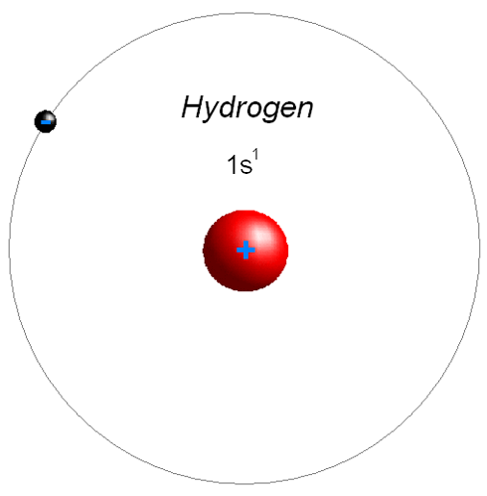
Hydrogen
+

Slide 4
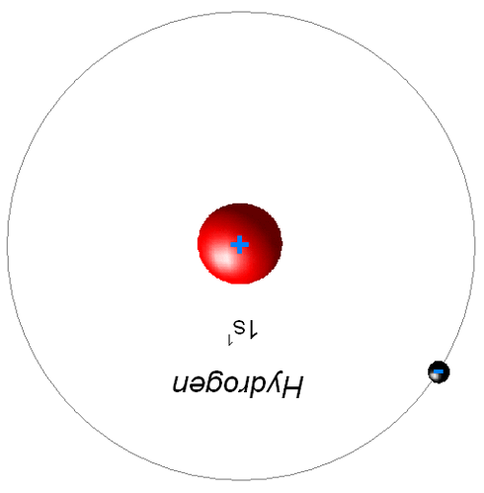
See it yet?
+

Slide 5
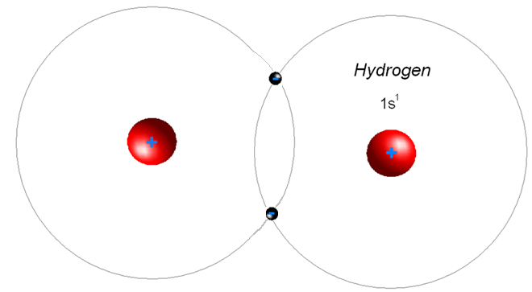
Hydrogen or H₂

Slide 6
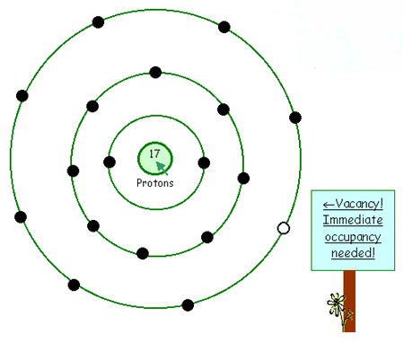
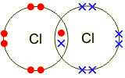
Chlorine – Draw this one... x2
Answer

Slide 7
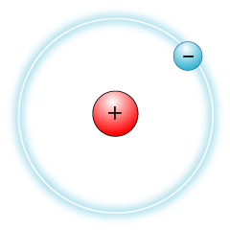


Slide 8
When the atoms are close, the attractions are so strong that a molecule of hydrogen (H₂) is formed.
The atoms are held together by the attractions between the two nuclei and the shared pair of electrons. This is a single covalent bond.

Slide 9
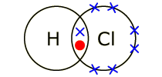
Hydrogen and Chlorine?

Slide 10
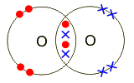
Oxygen? O2

Slide 11
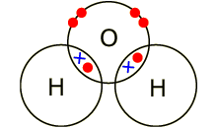
Water, H2O

Slide 12
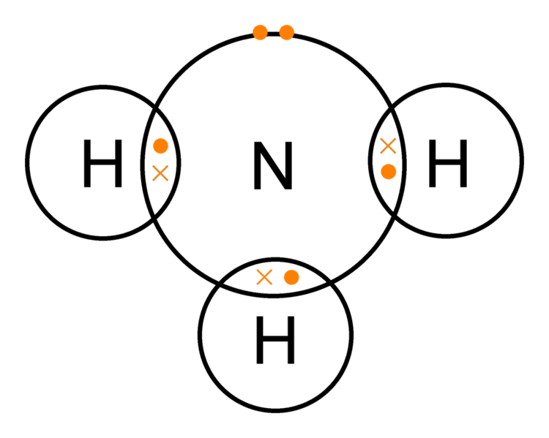
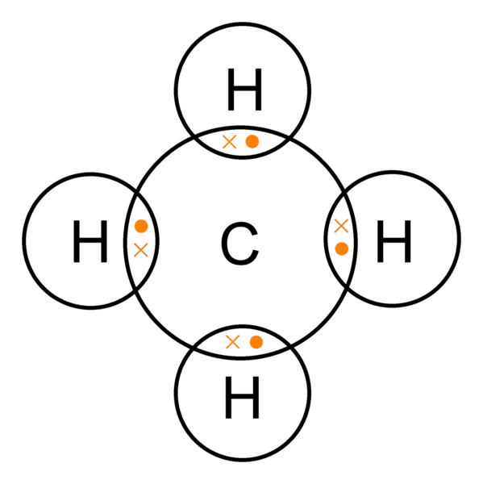
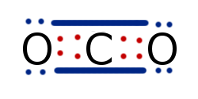
Show your working:
Ammonia ; NH3
Methane; CH4
Carbon Dioxide; CO2

Slide 13
Properties
The Bonds between the Atoms are STRONG;
Van der Waals Forces (Intermolecular Forces) between molecules are weak
They don’t conduct electricity
They are usually gasses
Usually non-metals

Slide 14
Activity
Lucarelli
Page 11
Set 3 Except no. 8. (empirical formulae)
Then Page 32 & 35
Set 9 [Ionic] & 10 [Covalent]

